Slide 1

MCMC I for Infectious Diseases
Lab & Activity

Slide 2



Resources
Presentation Activity
Toolbox Code
Toolbox Tutorial
PollEv.com​/amandableichrodt759
https://github.com/gchowell/paramEstimation_forecasting_ODEmodels
https://pubmed.ncbi.nlm.nih.gov/38378161/

Slide 3

Emory’s Apporto
https://rsphemory.apporto.com/

Slide 7
Uploading Materials

Slide 10
Downloading Data

Slide 13
Exploring MATLAB

Slide 15
Needed Settings
Needed MATLAB Functions
Curve Fitting Toolbox
Global Optimization Toolbox
Optimization Toolbox
Signal Processing Toolbox
Simulink
Statistics and Machine Learning Toolbox
Needed Folders
input
output

Slide 16
Adding Packages
*Not needed if using Emory’s Virtual Lab

Slide 25
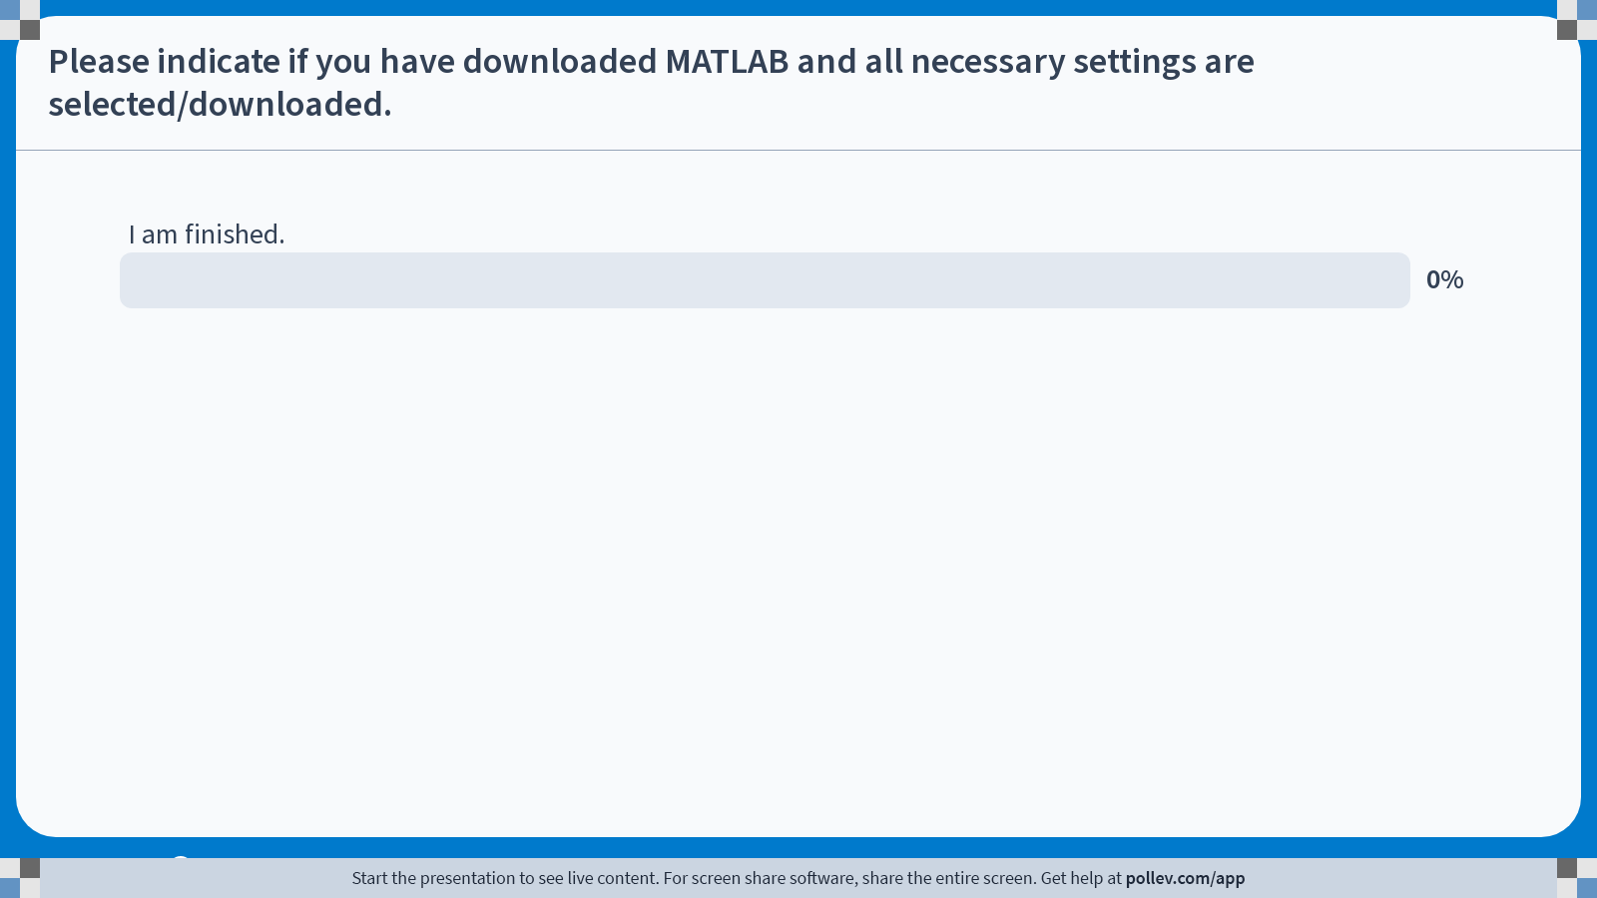
Notes:
Poll Title: Do not modify the notes in this section to avoid tampering with the Poll Everywhere activity. More info at polleverywhere.com/support Please Indicate if you have downloaded MATLAB and all necessary settings are selected/downloaded. https://www.polleverywhere.com/multiple_choice_polls/rfjjL9JIE8wYGwj4mF9dY?state=opened&flow=Default&onscreen=persist

Slide 26
The QuantDiffForecast Toolbox

Slide 27
Multiple parameter estimation options
Estimation: NLSQ & MLE
Flexible model specifications
User specified system of ODEs
Evaluation of bootstrapping error, model fit and forecasting performance
Mean Squared Error (MSE)
Error distributions: Normal, Poisson, and four variations of negative binomial
Bootstrapping and number of initial guesses
Initial parameter and state variable conditions
Estimation of composite function(s) from the specified model parameters
Mean Absolute Error (MAE)
Weighted Interval Scores (WIS)
95% PI Coverage
Monte Carlo Squared Error (MCSE)

Slide 28
Downloading the Toolbox

Slide 35
Setting up the Working Directory

Slide 40
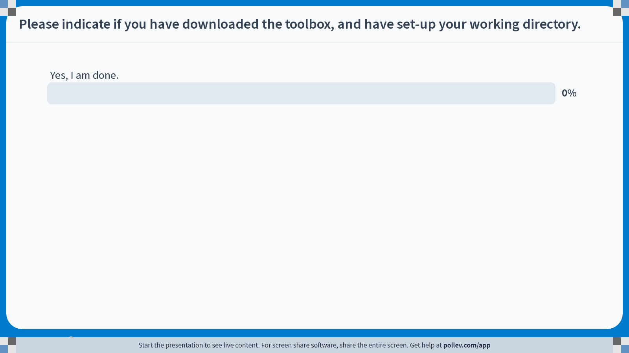
Notes:
Poll Title: Do not modify the notes in this section to avoid tampering with the Poll Everywhere activity. More info at polleverywhere.com/support Please indicate if you have downloaded the toolbox, and have set-up your working directory. https://www.polleverywhere.com/multiple_choice_polls/lxEoKFIxx9mxAcK9ZM8Pa?state=opened&flow=Default&onscreen=persist

Slide 41
Preparing for the Tutorial

Slide 42
Workflow
(1) Specifying the ODE Model and Preparing the Data
(2) Model Code and Testing
(3) Fitting the model to data with quantified uncertainty
(4) Plot the mean model fits and compute calibration period performance metrics
(5) Generating and evaluating model-based forecasts
(6) Plotting the model-based forecasts and performance metrics

Slide 43
Tutorial #1: 1918 Influenza

Slide 44
Daily incident curve of the fall wave of the 1918 influenza pandemic in San Francisco.
Data obtained from Chowell et al. JR Society Interface. 2007

Slide 45
Preparing the data

Slide 46
Set-Up
File Name
File Structure
Two folders are needed in your working directory: (1) input & (2) output
Data goes in the input folder
No formal file naming conventions must be followed IF working with incident data
If working with CUMULATIVE incidence count data, the name of the time series data file must start with cumulative
1st Column: Time Index (0, 1, 2…)
2nd Column: Temporal Incidence
Columns should NOT have headers
Data should be in .txt format

Slide 48
Specifying the ODE Model

Slide 49
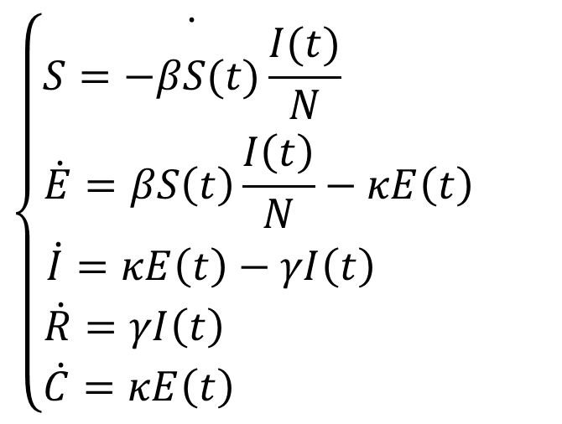
Specifying the SEIR Model
$$\left\{\begin{aligned}\dot{S=−βS(t)\frac{I(t)}{N}} \\ \dot{E}=βS\left(t\right)\frac{I\left(t\right)}{N}−κE\left(t\right) \\ \dot{I}=κE\left(t\right)−γI\left(t\right) \\ \dot{R}=γI\left(t\right) \\ \dot{C}=κE\left(t\right) \end{aligned}\right.$$

Slide 50
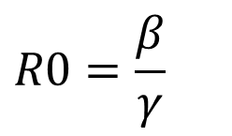
Specifying the R0 Function
In addition to specifying the ODE model, users can choose to specify a composite function using parameters specified in the ODE file
For this tutorial, we use the following calculation for R0:
$$R0=\frac{β}{γ}$$

Slide 51
Preparing the options_fit.m file

Slide 52
Overview
Prior to fitting the model to data, multiple parameters must be specified in an options_fit.m structured file.
Name of options_fit file can be customized.
Required Specification Sections :
Dataset Properties
Parameter Estimation
ODE Model
Rolling Window Analysis
Tutorial: We will be using two different options_fit.m files for this tutorial:
options_fit_SEIR_flu1918_dist1_1
options_fit_SEIR_flu1918_dist1_3

Slide 53
cadfilename1: The name of the data file.
caddisease: Name of the process of interest
datatype: Nature of the data

Slide 54
method1: The type of estimation method.
Five options available: NLSQ, MLE Poisson, and three MLE Neg. Binomial options
The estimation method option should match the appropriate error structure.
(2)dist1: Error structure
Six options available: Normal, Poisson, and four Neg. Binomial options
(3)numstartpoints: Number of initial
guesses for optimization procedure
(4)B: Number of bootstrap realizations
*Tutorial: As we are working with smaller case counts, we will stick with Poisson and Negative Binomial error structures.

Slide 55
Specifying the ODE Model – options_fit.m

Slide 56
windowsize1: The size of the moving window or calibration period
(2)tstart1: Start of the rolling window analysis
(3)tend1: End of the rolling window analysis
(4)printscreen1: Show the plots at the conclusion of running code

Slide 57
Rolling Window Analysis
A rolling window analysis can be useful to assess the stability of the model parameters and forecasts over
Controls the data used to calibration the model (i.e., data that goes into the model)
Example: tstart1 = 1, tend1 = 2, windowsize1 = 5
Time | 0 | 1 | 2 | 3 | 4 | 5 | 6 | 7 | 8 | 9 | 10 | 11 | 12 | 13 | 14 | 15
Cases | 1 | 2 | 5 | 8 | 9 | 1 | 2 | 1 | 1 | 5 | 3 | 6 | 9 | 4 | 8 | 0
Rolling Window #1
Rolling Window #2

Slide 58
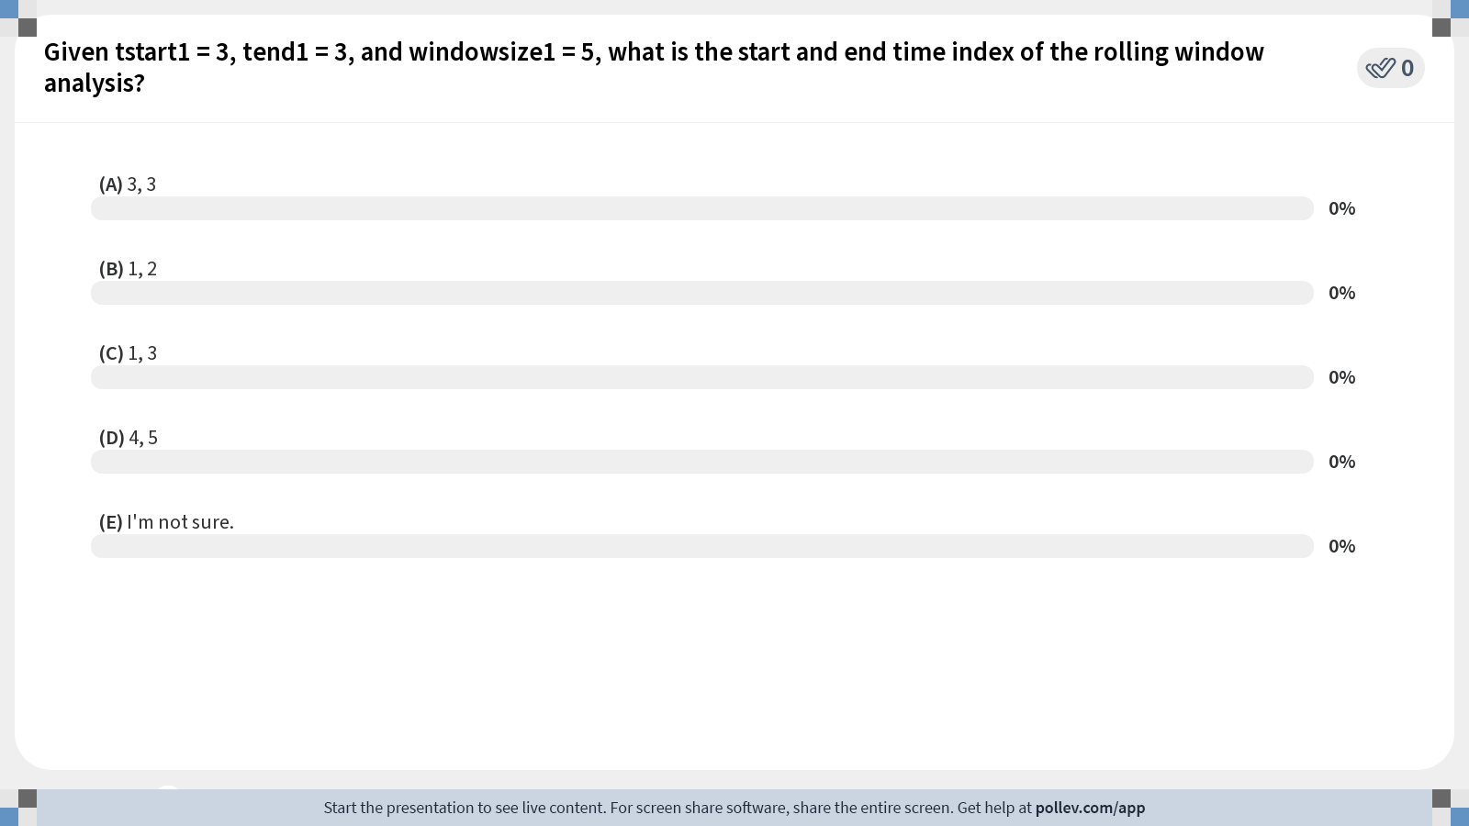
Time | 0 | 1 | 2 | 3 | 4 | 5 | 6 | 7 | 8 | 9 | 10 | 11 | 12 | 13 | 14 | 15
Cases | 1 | 2 | 5 | 8 | 9 | 1 | 2 | 1 | 1 | 5 | 3 | 6 | 9 | 4 | 8 | 0
Notes:
Poll Title: Do not modify the notes in this section to avoid tampering with the Poll Everywhere activity. More info at polleverywhere.com/support Given tstart1 = 3, tend1 = 3, and windowsize1 = 5, what is the start and end time index of the rolling window analysis? https://www.polleverywhere.com/multiple_choice_polls/N6Q5h8pwyvlf9TOp5ZE76?state=opened&flow=Default&onscreen=persist

Slide 59
Generating preliminary model solutions
plotODEModel()

Slide 60
Overview
Its often helpful to check that the user has correctly specified the model by checking that the model’s solutions for the parameter ranges specified by the user correspond to a broad range of expected solutions
plotODEModel(@optionsFitFileName)
Produces plots showing model solutions of state variables by generating a random sample of parameter sets from the specified parameter ranges and time-period
Tutorial Code Call
plotODEModel(@options_fit_SEIR_flu1918_dist1_1)

Slide 61
Time-series data
B model solutions
Model solution that follows the data most closely based on the sum of squared errors
Notes:
Poisson

Slide 63
Fitting, plotting, and evaluating the model with quantified uncertainty
Poisson and Neg. Binomial Error Structures

Slide 64
Step One: Fitting the Model to Data
Prior to obtaining model fit files and plotting the model fit, we first must fit the model to data with quantified uncertainty using the following code call:
Run_Fit_ODEModel(@OptionsFitFileName,tstart1,tend1,windowsize1)
tstart1, tend1, and windowsize1 correspond to the values entered in the rolling window analysis section of the options_fit.m file.
Tutorial Code: (1) Poisson & (2) Negative Binomial
Run_Fit_ODEModel(@options_fit_SEIR_flu1918_dist1_1, 1, 1, 17)
Run_Fit_ODEModel(@options_fit_SEIR_flu1918_dist1_3, 1, 1, 17)

Slide 65
Step Two: Plotting the model fit
After obtaining the model fits, we can obtain information related to: (1) model fit, (2) model parameter estimates, (3) Monte Carlo standard errors, (4) AICc values, (5) calibration performance metrics, & (6) composite parameter information for the specified model and data using the following call (.csv files in output)
plotFit_ODEModel(@OptionsFitFileName,tstart1,tend1,windowsize1)
tstart1, tend1, and windowsize1 correspond to the values entered in the rolling window analysis section of the options_fit.m file.
Tutorial Code Call: (1) Poisson & (2) Negative Binomial
plotFit_ODEModel(@options_fit_SEIR_flu1918_dist1_1, 1, 1, 17)
plotFit_ODEModel(@options_fit_SEIR_flu1918_dist1_3, 1, 1, 17)

Slide 66
Poisson Output <dist1 = 1>

Slide 67
Time-series data
Median Model Fit
Model fits of 300 bootstrap realizations
Predictive uncertainty

Slide 71
Neg. Binomial Output <dist1 = 3>

Slide 76
Model Fit Comparison

Slide 77
Poisson
Neg. Binomial

Slide 78
Poisson
Neg. Binomial

Slide 79
Model | MAE | MSE | Coverage 95% PI | WIS
SEIR model with Poisson error structure (<dist1>=1) | 5.72 | 58.59 | 58.82 | 3.87
SEIR model with negative binomial error structure (<dist1>=3) | 5.73 | 58.21 | 94.12 | 3.67
* Obtained from .csv performance-calibration… files

Slide 80
Generating, plotting and assessing model-based forecasts
Neg. Binomial Error Structure & Exponential Model

Slide 81
Step One: Preparing the Code
(1)getperformance: Indicator for calculating forecast performance
metrics.
If the forecasting period extends past the available data, getperformance must be marked zero, or an error will occur.
(2)forecastingperiod:The forecasting horizon (i.e., how many time
points ahead the toolbox should predict)
File Name: options_forecast_SEIR_flu1918_dist1_3

Slide 82
Step Two: Generating Forecasts
Prior to obtaining model fits, forecasts, and associated evaluation criteria we must generate forecasts using the following code call:
Run_Forecasting_ODEModels(@OptionsForecastFileName,tstart1,tend1,windowsize1, forecastingperiod)
tstart1, tend1, windowsize1, and forecastingperiod correspond to the values entered in the rolling window analysis section of the options_forecast.m file.
Tutorial Code: (1) SEIR Negative Binomial
Run_Forecasting_ODEModel(@options_forecast_SEIR_flu1918_dist1_3, 1, 1, 17,10)

Slide 83
Step Three: Plotting Forecasts
After generating the model forecasts, we can obtain information related to: (1) forecasts, (2) model parameter estimates, (3) Monte Carlo standard errors, (4) AICc values, (5) calibration performance metrics, (6) forecast performance metrics, & (7) composite parameter information for the specified model and data using the following call (.csv files in output)
plotForecast_ODEModel(@OptionsForecastFileName,tstart1,tend1,windowsize1, forecastingperiod)
tstart1, tend1, windowsize1, and forecastingperiod correspond to the values entered in the rolling window analysis section of the options_forecast.m file.
Tutorial Code: (1) SEIR Negative Binomial
plotForecast_ODEModel(@options_forecast_SEIR_flu1918_dist1_3, 1, 1, 17,10)

Slide 84
Calibration Period
Forecast Period
Timeseries Data
Median Forecast/Fit
Predictive uncertainty
Model fits of 300 bootstrap realizations

Slide 88
Model Comparison
SEIR Neg. Binomial & Exponential Neg. Binomial

Slide 89
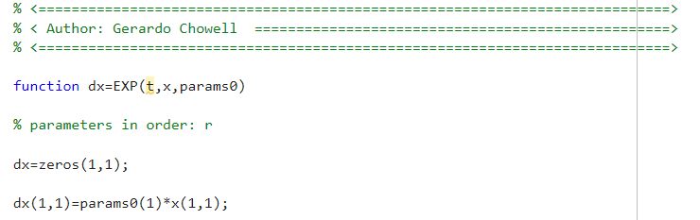
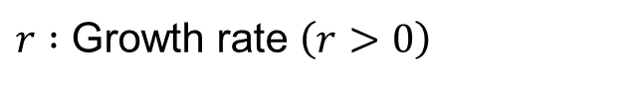
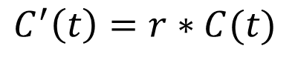
Specifying the Exponential Model
$$C^{′}\left(t\right)=r∗C(t)$$
$r :$ Growth rate $\left(r>0\right)$
Run_Forecasting_ODEModel(@options_forecast_EXP_flu1918_dist1_3, 1, 1, 17)

Slide 93
Model | MAE | MSE | Coverage 95% PI | WIS
Calibration Performance
SEIR model with NB error structure (<dist1>=3) | 5.74 | 59.51 | 94.12 | 3.66
Exponential model with negative binomial error structure (<dist1>=3) | 5.99 | 67.03 | 100.0 | 3.84
Forecast Performance
SEIR model with NB error structure (<dist1>=3) | 65.48 | 8058.65 | 70.0 | 49.80
Exponential model with negative binomial error structure (<dist1>=3) | 79.79 | 9252.18 | 90.0 | 46.72

Slide 94
Tutorial #2: Swiss COVID-19

Slide 95
Daily number of reported cases of SARS-CoV-2 infection in Switzerland reported at the national level during the first wave (Feb. 2020 to June 2020).
Data obtained from Grinsztajn et al. Statistics in Medicine. 2021

Slide 96
Specifying SEIURC and R0
Early Phase

Slide 97
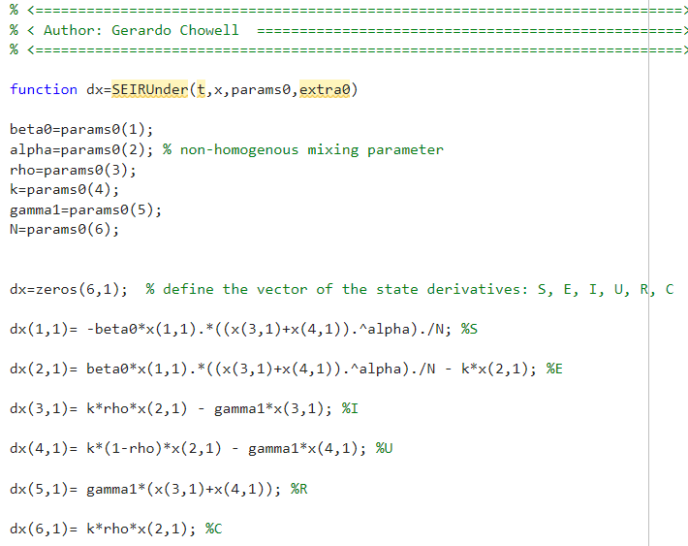
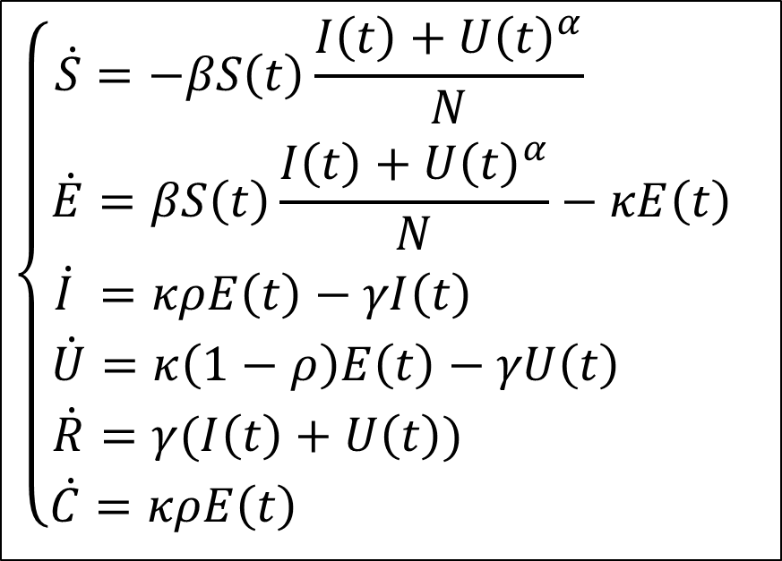
$$\left\{\begin{aligned}\dot{S}=−βS\left(t\right)\frac{I\left(t\right)+U{\left(t\right)}^{α}}{N} \\ \dot{E}=βS\left(t\right)\frac{I\left(t\right)+U{\left(t\right)}^{α}}{N}−κE\left(t\right) \\ \dot{I} =κρE\left(t\right)−γI\left(t\right) \\ \dot{U}=κ\left(1−ρ\right)E\left(t\right)−γU\left(t\right) \\ \dot{R}=γ(I\left(t\right)+U\left(t\right)) \\ \dot{C}=κρE\left(t\right) \end{aligned} \right.$$

Slide 99
Preparing options_fit.m & options_forecast.m
Fitting and forecasting the early growth phase (First 20-days)

Slide 100
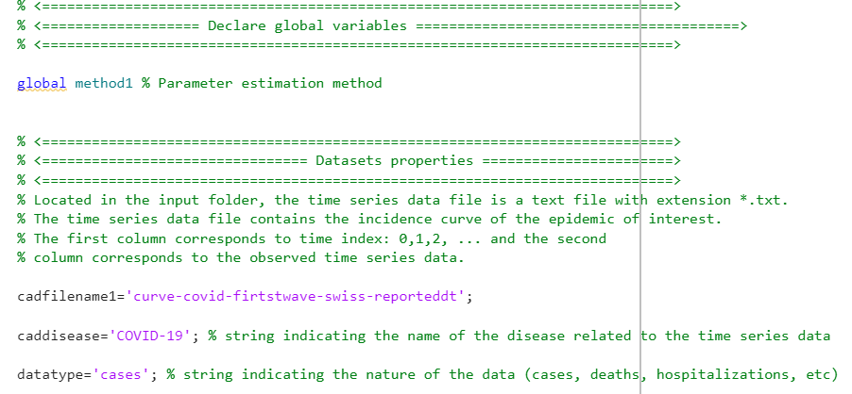

Slide 101
Tutorial
As the case counts are much higher compared to Tutorial #1, we will be using nonlinear least squares (NLSQ) and assuming a normal error distribution.
Using 32 start points (<numstartpoints> = 32)
Using 300 bootstrap realizations to characterize parameter uncertainty (<B> = 300)

Slide 102
Fitting to the first 20 days

Slide 103
Generating preliminary model solutions
plotODEModel(@options_fit_SEIR_unreportedNIn_covid_swiss_dist1_0)

Slide 104

Fixed $α$

Slide 105
Fixed $α$

Slide 106
Fitting, plotting, and evaluating the model with quantified uncertainty
Run_Fit_ODEModel(@options_fit_SEIR_unreportedNIn_covid_swiss_dist1_0, 1, 1, 20)
plotFit_ODEModel(@options_fit_SEIR_unreportedNIn_covid_swiss_dist1_0, 1, 1, 20)

Slide 107
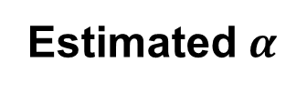

Fixed $α$
Estimated $α$

Slide 108
Fixed $α$

Slide 109
Fixed $α$

Slide 110
Fixed $α$

Slide 111
Generating, plotting and assessing model-based forecasts
(1)Run_Forecasting_ODEModel(@options_forecast_SEIR_unreportedNIn_covid_swiss_dist1_0, 1, 1, 20,10)
(2)plotForecast_ODEModel(@options_forecast_SEIR_unreportedNIn_covid_swiss_dist1_0, 1, 1, 20,10)

Slide 112
Fixed $α$

Slide 113
Fixed $α$

Slide 114
Model Comparison (Early Phase)
SEIUR Normal, GGM Normal & RICH Normal

Slide 115
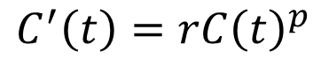
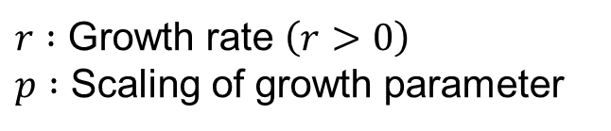
Specifying the GGM Model
$$C^{′}\left(t\right)=rC{\left(t\right)}^{p}$$
$r :$ Growth rate $\left(r>0\right)$
$p :$ Scaling of growth parameter

Slide 119
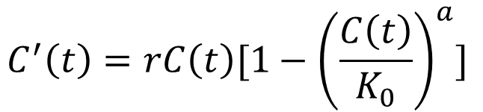
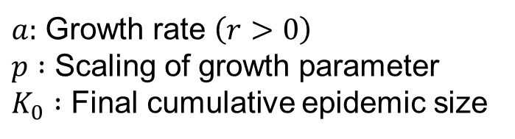
Specifying the RICH Model
$$C^{′}\left(t\right)=rC{\left(t\right)[1−{\left(\frac{C\left(t\right)}{K_{0}}\right)}^{a}]}^{ }$$
$a:$ Growth rate $\left(r>0\right)$
$p :$ Scaling of growth parameter
$K_{0} :$ Final cumulative epidemic size

Slide 123
Model | MAE | MSE | Coverage 95% PI | WIS
Calibration Performance
SEIUR model with NLSQ/ Normal error structure (<dist1>=0) | 40.1 | 3299.6 | 90.0 | 23.8
GGM with Normal error structure (<dist1>=0) | 21.1 | 1191.0 | 100.0 | 15.2
RICH with negative binomial error structure (<dist1>=0) | 22.6 | 1037.1 | 100.0 | 14.0
Forecast Performance
SEIUR model with NB error structure (<dist1>=0) | 4475.0 | 46849766.5 | 10.0 | 3893.0
GGM with negative binomial error structure (<dist1>=0) | 254.6 | 91255.1 | 70.0 | 171.5
RICH with negative binomial error structure (<dist1>=0) | 533.4 | 368516.5 | 20.0 | 428.6

Slide 124
Specifying SEIURC
All Data

Slide 125
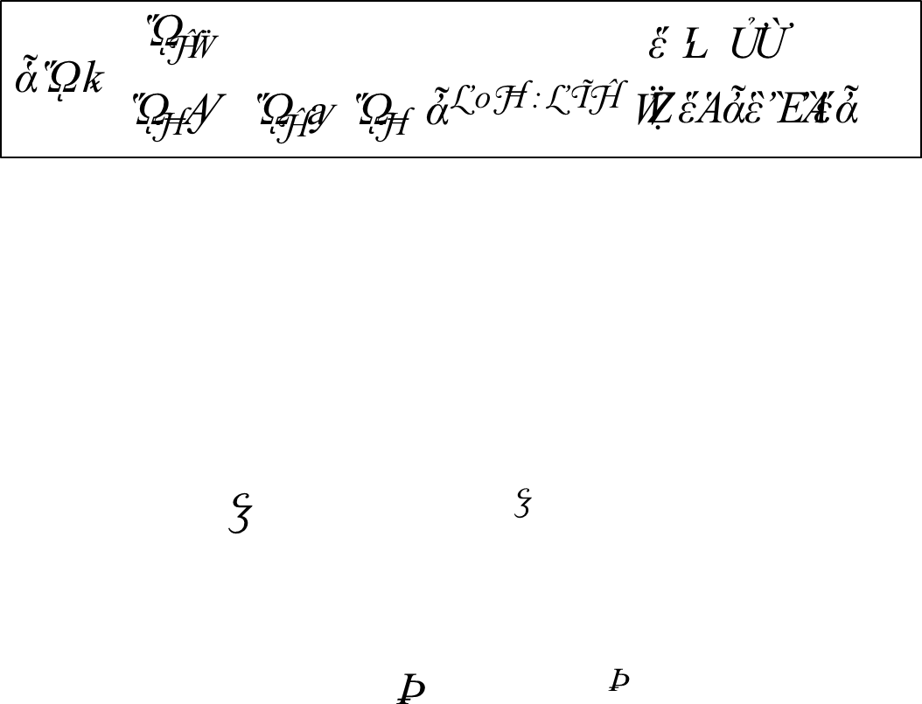
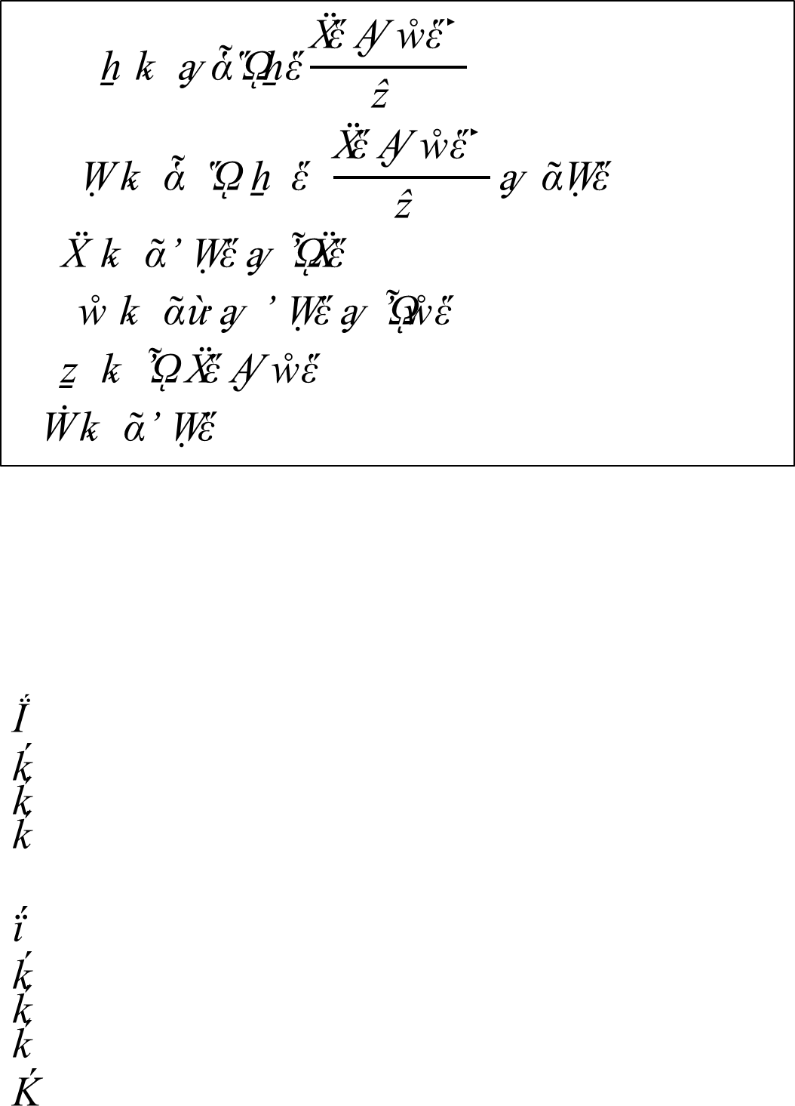
$$f\left(β\right)=\left\{\begin{aligned}β_{0,} \\ β_{1}+\left(β_{0}−β_{1}\right)e^{−q1\left(t−20\right)},\end{aligned}{t<20 \atop Otherwise}\right.$$
$$\left\{\begin{aligned}\dot{S}=−f\left(β\right)S\left(t\right)\frac{I\left(t\right)+U{\left(t\right)}^{α}}{N} \\ \dot{E}=f(β)S(t)\frac{I\left(t\right)+U{\left(t\right)}^{α}}{N}−κE\left(t\right) \\ \dot{I} =κρE\left(t\right)−γI\left(t\right) \\ \dot{U}=κ\left(1−ρ\right)E\left(t\right)−γU\left(t\right) \\ \dot{R}=γ(I\left(t\right)+U\left(t\right)) \\ \dot{C}=κρE\left(t\right) \end{aligned} \right.$$

Slide 127
Preparing options_fit.m
Fitting using all data

Slide 128
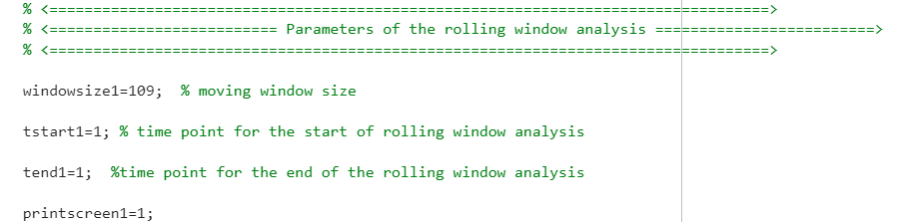

Slide 129
Generating preliminary model solutions
plotODEModel(@options_fit_SEIR_unreported_covid_swiss_dist1_0)

Slide 130

Estimated $α$

Slide 131
Estimated $α$

Slide 132
Fitting, plotting, and evaluating the model with quantified uncertainty
(1)Run_Fit_ODEModel(@options_fit_SEIR_unreported_covid_swiss_dist1_0, 1, 1, 109)
(2)plotForecast_ODEModel(@options_fit_SEIR_unreported_covid_swiss_dist1_0, 1, 1, 109)

Slide 133
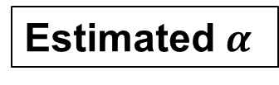

Fixed $α$
Estimated $α$

Slide 134
Estimated $α$

Slide 135
Estimated $α$

Slide 136
Model Comparison (All Data)
SEIUR Normal, GGM Normal & RICH Normal

Slide 139
Model | MAE | MSE | Coverage 95% PI | WIS
Calibration Performance
SEIUR model with NLSQ/ Normal error structure (<dist1>=0) | 67.2 | 13189.4 | 92.7 | 48.3
GGM with Normal error structure (<dist1>=0) | 297.6 | 197605.8 | 88.1 | 176.6
RICH with negative binomial error structure (<dist1>=0) | 284.3 | 216949.7 | 89.0 | 173.1

